Slide 1
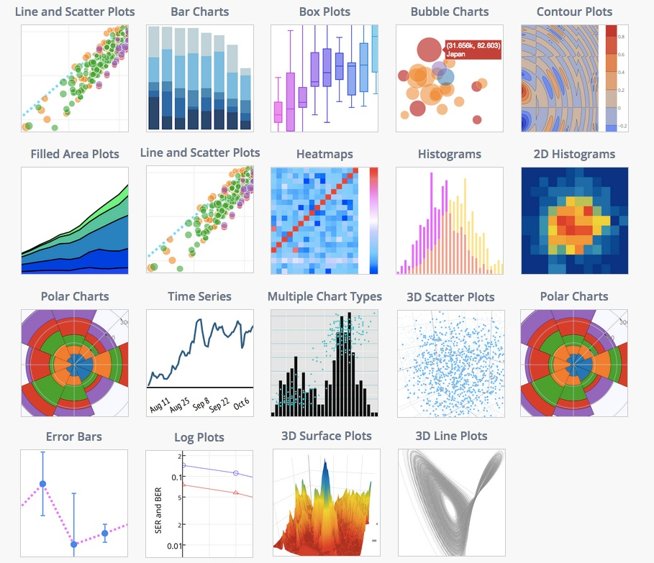



INTERACTIVE DATA VISUALIZATION
Jupyter Notebook
Data represented in a visual format that helps people to extract meaning from that data much more quickly and easily.
Plotly interactive controls:
Buttons
Dropdowns
Slider
Analyze and visualize data together…
Shiela Jimenez
Data Scientist

Slide 2
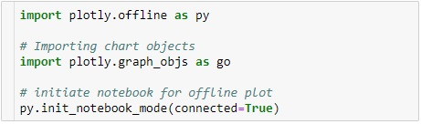
Plotly
Interactive controls (button, dropdown and slider)
Plotly is an online analytics and visualization libraries for JavaScript, python, R etc. The core library is written on top of D3 so the charts are interactive
Installation :
Module imports:
Offline plotly: Allows you to create graphs offline.
Demo:
pip install plotly or
pip install plotly -- upgrade

